Slide 1
UNIT-1
BLOCKCHAIN FUNDAMENTALS

Slide 2
Blockchain Definition
A blockchain is a decentralized database that coordinates agreement on an append-only history of transactions across a peer-to-peer network.

Slide 3
Decentralized Database
A database is simply a collection of data or information. A phonebook, bank for example.
A decentralized database is one where there is no single, centralized storage of data and no single authority or system administrator.
Decentralized databases generally have multiple readers and multiple writers such as when multiple servers on a network provide data to clients.
An additional form of information architecture is a distributed database, where all the nodes on the network contain information and they are equal and have equal rights.
Blockchains are intermittently referred to as both decentralized and distributed, since they often have both qualities (independent nodes and full replication and rights).
We will consider the blockchain to be decentralized.

Slide 4
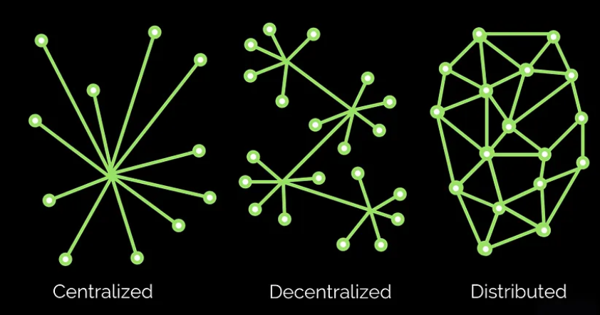

Slide 5
History of Transactions
A blockchain coordinates agreement around a “history of transactions.”
A key feature of blockchain technology is that it is a specialized kind of database, called a distributed ledger.

Slide 6
Peer-to-Peer Network
Blockchain is one manifestation of Distributed Ledger Technology (DLT).
All variations of DLTs share two core features: 1. running on a peer-to-peer (p2p) network and 2. using a consensus protocol among the peers (or nodes) in order to come to an agreement about the database, instead of relying on a centralized administrator to perform this function.
This is why our definition describes blockchains as including a “peer-to-peer network.”
The database is held locally by all the peers that participate as a full node on the network. These nodes function as a community of verifiers for the database.

Slide 7
Elements Of Blockchain
Nodes
Blocks
Public and Private Keys
Mining
Tokens or Coins
Proof of Work (Consensus)

Slide 8
Nodes in Blockchain
Full Node
It includes complete copy of the blockchain and fully validates the transaction and blocks.
Partial Node
Points to full node for their data.

Slide 9
Full-Node
A full node includes the complete copy of the blockchain and also works to fully validate both the transactions and the blocks.
To operate as a full node on a blockchain application certainly requires a high-powered computer setup, including lots of Random Access Memory (RAM), large quantities of free space on the hard drive, and a good broadband connection.
One user can operate multiple nodes on a blockchain, and there also exist “partial nodes” that point to full nodes for their data.

Slide 10
Blocks
Any full node participating on a blockchain can gain the right to package the transactions as they occur into a block.
Blocks on the Bitcoin blockchain are currently about 1 MB in size and take about ten minutes to create.
Once a block is created, it is linked to the previous block using a special address as well as cryptography.
Looking at transactions in a blockchain you will mostly see numbers and letters, representing the alphanumeric address associated with the transaction, as well as the hash (or compression) of the previous blocks.

Slide 11
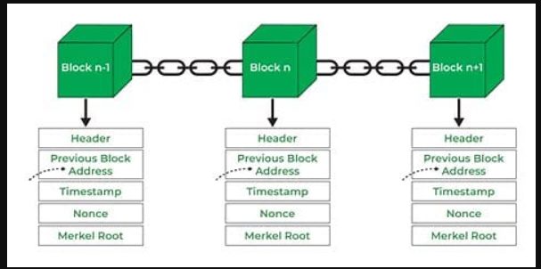

Slide 12
A block in a blockchain is a fundamental building unit that stores and encrypts information. Here are the key points:
A block is a place within the blockchain where data is permanently recorded.
It contains transaction information from previous blocks and new transactions.
Components of a block include:
Block size: Sets the size limit for data storage in the block.
Block header: Contains essential block information.
Transaction counter: Indicates the number of transactions stored in the block.
Transactions: A list of all transactions within the block.
The block header includes:
Version: The blockchain version used.
Previous block hash: Hash of the previous block’s header.
Merkle root hash: Hash of transactions in the current block.
Time: Timestamp for block placement in the blockchain.
Bits: Difficulty rating for solving the nonce.
Nonce: Encrypted number miners must solve to verify and close the block.

Slide 13
Transactions
Economic transactions, including buying and selling goods and services.
Returning a purchase or calling customer support.
It can encompass behavior as simple as liking something on Facebook or exchanging phone numbers among friends.
The Check Book Analogy

Slide 14
Public and private key
Verify transactions without necessarily revealing lots of personal information.
Use a private key to unlock their address while only sharing a public key with the others involved in the transaction.
With an address on a blockchain network, you have a public portion of your account address and a private portion that allows you (and only you) to unlock access to it for making transactions.
To perform transactions on a blockchain, you need to digitally sign your transactions with your private key.

Slide 15
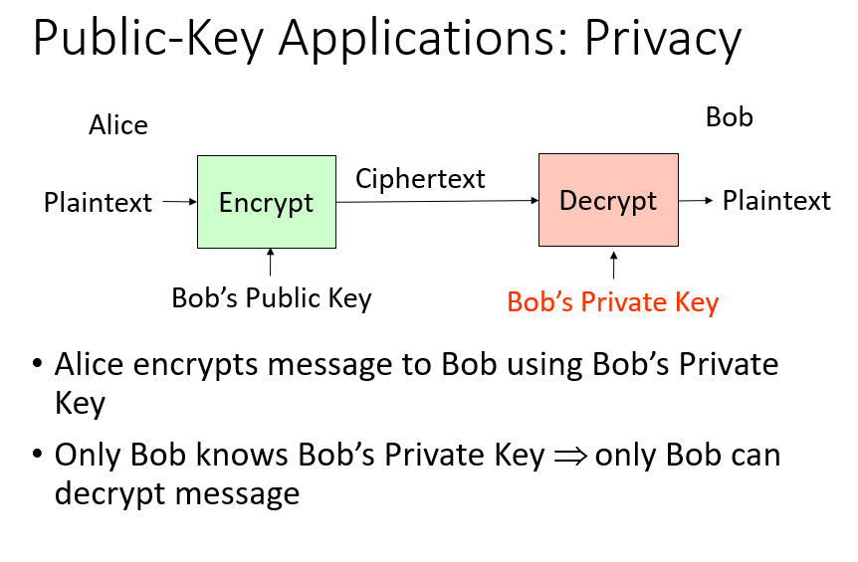

Slide 16
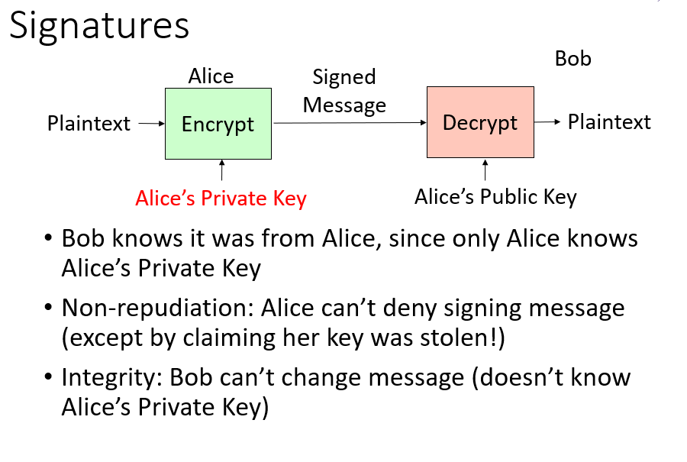

Slide 17
Mining
A full node helps validate a blockchain database through a practice called mining.
Miners are nodes that perform a certain amount of computational work – racing with each other to solve a mathematical puzzle – in order to help keep the network going.
Every time a miner successfully solves the puzzle, they win the right to contribute the newest block of transactions to the blockchain.
The winning miner sends out a message to the entire network, and receives newly minted tokens as an incentive in exchange for the service of helping maintain the database by mining.

Slide 18
Tokens or Coins
To motivate people to participate in a blockchain as a full node and help secure the history of transactions in the database, these systems include an incentive structure that uses “digital tokens”.
A digital token is just a way of representing a value on a blockchain application.

Slide 19
PoW Proof of Work (Consensus mechanism)
How do you create agreement and a shared reality across nodes in a blockchain system?
In Proof of Work, what happens across the network is essentially a grand competition between all of the nodes running the blockchain software.
They are competing to solve a large mathematical puzzle, and whichever node solves the puzzle first, wins the right to package the latest transaction data into a block, around which the remaining nodes form consensus (this competition is the act of mining).

Slide 20
Qualities of Blockchain
Security
Resiliency / Fault Tolerance
Immutability
Transparency
Verifiability
Permissibility

Slide 21
Security
Each new block on a blockchain is cryptographically secured through hash functions, and when a new block is mined, the blockchain is immediately synchronized with the rest of the network.
Due to the decentralized nature of a blockchain network, for someone to hack or tamper with a blockchain, a majority of the nodes would need to be compromised, which is called a “51% attack.”
However, accomplishing this kind of network takeover requires a massive amount of computing power and cost.
This means that the larger the network gets, the more difficult it is to alter any transactions stored on its blockchain, making the chance of fraudulent transactions on the blockchain very low.

Slide 22
Resiliency/Fault Tolerance
The fact that all the nodes on the network contain exact copies of the entire blockchain also means that the system has been designed to be very resilient.
If one node goes down or decides to quit, the other nodes will continue to perform all the functions necessary to keep the network going.
The fact that blockchains are decentralized peer-to-peer networks also means that the computers behind the nodes may be located all over the world; making it highly unlikely that the system will go down due to power failures, geopolitical issues, weather, or other technical issues.
This quality of system resilience is also sometimes referred to as “fault tolerance.”

Slide 23
Immutable
This just means that once a block of transactions has been added to the chain it cannot be deleted or changed.
If transactions could be easily deleted or changed after the fact, then this would be a source of disputes among the participants.

Slide 24
Transparency
All of the transactions stored in a blockchain are visible to all of its participants.
This is true whether the transactions are huge or infinitesimally small.
This ensures that everything that has been verified as true by the consensus of the participating nodes can be seen by everyone participating in the blockchain.
The history of transactions is also easy to see because each transaction is “time-stamped.”
This time-stamping feature is part of the chronology of blocks and is crucial for allowing participants to accurately verify transactions.

Slide 25
Verifiability
Not all data needs to be visible to everyone so long as you can maintain verifiability of transactions.
This is true in particular for the personal data of the individuals involved in a given transaction.
Depending on the sensitivity of a transaction it may make sense to use a blockchain for verifiability but make sure that data such as health records or identity are protected.

Slide 26
Permissibility
One way to deal with who sees what is on a blockchain, is to leverage permissibility as part of a blockchain design.
Some blockchains are permissionless, while others allow for scoping of who participates, making them “permissioned.”
Both verifiability and permissibility are present in current iterations of blockchain, but these characteristics are also being achieved differently by developers.

Slide 27
Blockchain and Economics
Blockchain technology is closely connected to the field of economics for two reasons
1. Blockchains create a shared reality that is used for many kinds of economic transactions: between individuals, firms, and even objects.
2. The incentives baked into blockchain architecture (e.g. earning fractional token rewards for mining) require analysis from an economic perspective to make sure the system is not gamed or threatened by externalities.

Slide 28
Benefits
1. Lowering Uncertainty in Trade
Analogy: escrow account set up by a mortgage company
2. Changing the Role of the Firm: A Nexus of Smart Contracts
A smart contract is basically a small computer program that runs on a blockchain. It contains a series of “if-then” statements that execute automatically when certain conditions are met.
3. Decentralized Autonomous Organizations(DAO) / DAC:
A collection of smart contracts that could be used to create a set of interlocking rules for a digital corporation.

Slide 29
1. Lowering Uncertainty in Trade
Blockchain technology has at times been characterized as a “distributed trust network” because it relies on many nodes instead of a central authority.
From an economic standpoint, this kind of network can potentially replace some of the trusted third parties, or institutions, that have acted as trust brokers in our transactions to date.
The basic idea of blockchain is that we can use technology to disintermediate the institutions to transfer value directly.
In some ways, this looks more similar to our early agrarian transactions, where we could trade through barter in a more direct, one-to-one model.
For example, instead of using a bank or marketplace platform as a brokering source of trust, we can use a network like the Bitcoin blockchain to directly transfer value between two accounts.

Slide 30
1. Lowering Uncertainty in Trade (Contd.)
As an analogy, this might be similar to when you have an escrow account set up by a mortgage company.
Under the terms of the mortgage contract, an escrow account is set up to automatically disburse funds when taxes or insurance payments are due; usually every quarter.
For a blockchain, the funds are locked up until the terms of that transaction are met and the payment is triggered through code.
The mortgage process itself could be considered a use case for blockchain technology, and some companies are working on replacing the management of mortgages (and its inherent fees), with automated execution without error using the technology of blockchain.

Slide 31
2. Changing the Role of the Firm: A Nexus of Smart Contracts
A contract is generally the terms of an agreement between parties that is legally enforceable.
We can use blockchain technology to encode these relationships and agreements and take the place of the firm to some extent. This is the essence of the smart contract.
A smart contract is basically a small computer program that runs on a blockchain. It contains a series of “if-then” statements that execute automatically when certain conditions are met.
These are often called “self-executing” or “self-enforcing” contracts because we use the blockchain to execute the contracts automatically and accurately instead of blindly trusting the customer or paying lawyers to enforce them.

Slide 32
3.Decentralized Autonomous Organizations(DAO) / DAC
A Decentralized Autonomous Organization or “DAO” also interchangeably called DACs (Decentralized Autonomous Corporations) is a collection of smart contracts that could be used to create a set of interlocking rules for a digital corporation.
These digital-only entities are designed to run and maintain all their transactions and rules on a blockchain using smart contracts.
Other than participating in a DAC or DAO through private key digital signatures, these structures can potentially take over many functions that would usually require a board, or other governing body.

Slide 33
3.Decentralized Autonomous Organizations(DAO) / DAC
Contd. Examples:
DASH: DASH is a cryptocurrency started in 2014 that attempts to operate as a self-governing DAO, funding itself by allocating 10% of mining fees associated with its cryptocurrency propagation to the DAO.
“The DAO” was crowd-funded in 2016 and built on the Ethereum platform. It was designed to be a traditional venture fund that accepted proposals for projects to be built on Ethereum and grow the ecosystem of innovation for the platform.
The Crowdfunding platform in blockchain makes different possibilities for the startups by raising the funds to create their own digital currency and it is peer-to-peer fund raising model some of the famous crowdfunding cryptocurrencies are coinspace, swarm, judobaby etc.

Slide 34
Types of Blockchains
Public Block Chain
Private Blockchain
Permissioned Blockchain: the nodes are scoped to a known and approved set of participants.
Permissionless Blockchain: allows for anyone to participate as a node by installing the software and copying the blockchain onto their computers, such as in the case of Bitcoin;
Public permissioned blockchains

Slide 35
1. Public Blockchains
Public blockchains, like the Bitcoin network, allow anyone to write onto the blockchain or read from the blockchain.
Essentially, participation is completely open and voluntary.
In this sense, a public blockchain is similar to Wikipedia, since anyone can post or edit a page on the site. And like Wikipedia, there is a community of verifiers who reach a consensus about the validity of the transaction.
If a member of the blockchain repeatedly tries to submit invalid transactions, the blockchain community will start ignoring that particular node.
Also, you can see a history of all the changes in ownership of an asset on the blockchain, just as you can see a record of all the edits to a particular article on Wikipedia.

Slide 36
2. Private Blockchains
Businesses started to become especially interested in creating private blockchains so that they could enjoy the operational benefits of blockchain technology (e.g. a shared reality) without opening themselves and their data to the world.
In a private blockchain the reading and writing capabilities are scoped to a set of participants, and not publicly accessible.
Eventually, some of these private blockchains may migrate to becoming more public, but in the early stages, it makes sense to experiment in a more controlled sandbox rather than run the risk of transmitting or broadcasting sensitive data while still learning how to leverage this technology effectively.
For that reason, applications in healthcare, financial services, digital identity, and supply chain management are being developed using private blockchain architectures.
As an example, IBM has made this a big part of its corporate strategy and is actively promoting the Hyperledger framework for this kind of enterprise work.

Slide 37
3. Permissionless Blockchain
Put simply, permissionless means you can freely join and use a blockchain network and participate in consensus without first obtaining permission, approval, or authorization.
In contrast to permissionless blockchains, permissioned blockchains have gatekeepers that decide who can and cannot access, use, and govern the blockchain.
Examples of popular permissionless blockchains include Bitcoin (BTC), Ethereum (ETH), Cardano (ADA), and Dogecoin (DOGE).
With these blockchains, practically anyone can join the network; send and receive transactions; operate a node; view, copy and contribute to the code; and participate in the consensus process.

Slide 38
4. Permissioned Blockchains
Permissioned blockchains, on the other hand, limit who is allowed to participate in financial (or other) activities, and are typically controlled by a specific individual, entity, or group.
These permissioned blockchains are more commonly called private blockchains.
They are often used by businesses and political organizations that desire a secure database with controls.
This allows an organization to keep private data confidential while allowing it to leverage other benefits of blockchain.
Use cases for these systems include data storage, digital ID systems, and inventory and supply chain management.
Popular permissioned blockchains include Quorum, R3 Corda, and Hyperledger Fabric.

Slide 39
5. Public Permissioned Blockchains
Public permissioned blockchains are a hybrid form of blockchain networks that combine features of both public and permissioned blockchains. In a public permissioned blockchain, the network is open to anyone who wants to participate, much like a public blockchain.
However, unlike pure public blockchains like Bitcoin or Ethereum, where anyone can join anonymously and participate in block validation (mining), public permissioned blockchains require participants to be permissioned or authorized to interact with the network.
Key characteristics of public permissioned blockchains include:
1. Open Participation: Anyone can join the network and participate in transaction validation and consensus mechanisms. This open nature allows for decentralized participation.
2. Permissioned Validators: While the network is open to participation, validators (nodes responsible for validating transactions and adding them to the blockchain) are permissioned. This means that participants must be authorized or vetted by the network's administrators to become validators.
3. Transparency and Immutability: Like all blockchain networks, public permissioned blockchains maintain transparency and immutability of transaction records. Once transactions are recorded on the blockchain, they cannot be altered, providing a high level of trust and security.

Slide 40
4. Decentralization: Public permissioned blockchains aim to achieve decentralization by allowing a wide range of participants to contribute to the consensus process. However, the degree of decentralization may vary depending on factors such as the number of validators and the governance model of the blockchain.
5. Use Cases: Public permissioned blockchains are suitable for various use cases where transparency, decentralization, and regulatory compliance are essential. These may include supply chain management, identity verification, financial services, and government applications.
Overall, public permissioned blockchains offer a balance between the openness of public blockchains and the control of permissioned blockchains, making them suitable for applications that require a degree of decentralization while still adhering to regulatory requirements.

Slide 41
Business of Blockchain
Use Cases
1. Asset Tracking
2. Identity Management
3. Internet of Things (IoT) Integration
4. Decentralized Autonomous Supply Chains

Slide 42
1. Asset Tracking
Assets can be tangible things such as food, rare minerals, vehicles, and real estate. Or they can be intangible assets like patents, trademarks, copyrights, brands, and even the infamous “goodwill.”
For a tangible asset, it may be important to accurately know its identity, origin/source, and certification.

Slide 43
1. Asset Tracking (Contd.)
Consider Walmart, for example. They may receive a food alert related to an E-coli outbreak affecting romaine lettuce that they have sold in their stores. Once they learn about the outbreak, they need to quickly trace this lettuce back to the actual farm where it was grown and packed.
The lettuce may have been contaminated somewhere along the supply chain, too, so they need to identify all the different touch-points for the lettuce in question.
Likewise, they need to be able to identify who purchased the romaine lettuce that was contaminated. Walmart today has excellent systems for tracking items in its supply chains, which are some of the best in the world.
However, the company can still take weeks to get down to the granularity of the actual farmer or purchaser of the lettuce.
Supply chain recalls are costly and time-consuming. Blockchain technology offers major improvements in all areas of asset tracking.

Slide 44
1. Asset Tracking (Contd.)
The concept of asset tracking on a blockchain is a very powerful thing for businesses.
It means that we can quickly and efficiently track assets such as pharmaceuticals, artwork, land, and food from the producer to the consumer.
Tracking can include the provenance (or source of the items), attributes of the item itself for authentication, and any special certifications or transaction history that the asset may acquire along the way.
Tracking an asset through a blockchain means that the complete history of the asset can be made available to anyone we wish to share this with.

Slide 45
Ethical and Other Issues with Blockchain
What does it mean to have a global database (or computer) without a central authority that anyone can leverage to execute transactions?
As new technologies often are, questions will arise about who should be held responsible (if at all) for loss of funds or errors in code?

